Slide 1
Combinational Logic Design
9/15/09 - L12 Combinational Logic Design
Copyright 2009 - Joanne DeGroat, ECE, OSU

Slide 2
Class 12-Combinational Logic
Other gate types
Material from section 3-1 and 3-2 of text
9/15/09 - L12 Combinational Logic Design
Copyright 2009 - Joanne DeGroat, ECE, OSU

Slide 3
Combinational Logic Design
A process with 5 steps
  Specification
  Formulation
  Optimization
  Technology mapping
  Verification
1st three steps and last best illustrated by example
9/15/09 - L12 Combinational Logic Design
Copyright 2009 - Joanne DeGroat, ECE, OSU

Slide 4
Functional Blocks
Fundamental circuits that are the base building blocks of most larger digital circuits
They are reusable and are common to many systems.
Examples of functional logic circuits
  Decoders
  Encoders
  Code converters
  Multiplexers
9/15/09 - L12 Combinational Logic Design
Copyright 2009 - Joanne DeGroat, ECE, OSU

Slide 5
Where they are used
Multiplexers
  Selectors for routing data to the processor, memory, I/O
  Multiplexers route the data to the correct bus or port.
Decoders
  are used for selecting things like a bank of memory and then the address within the bank. This is also the function needed to ‘decode’ the instruction to determine the operation to perform.
Encoders
  are used in various components such as keyboards.
9/15/09 - L12 Combinational Logic Design
Copyright 2009 - Joanne DeGroat, ECE, OSU

Slide 6
Specifications step
Write a specification for the circuits
Specification includes
  What are the inputs: how many, how many bits in a given output, how are they grouped,, are they control, are they active high?
  What are the outputs: how many and how many bits in a each, active high, active low, tristate output?
  The functional operation that takes place in the chip, i.e., for given inputs what will appear on the outputs.
9/15/09 - L12 Combinational Logic Design
Copyright 2009 - Joanne DeGroat, ECE, OSU

Slide 7
Formulation step
Convert the specifications into a variety forms for optimal implementation.
  Possible forms
    Truth Tables
    Expressions
    K-maps
    Binary Decision Diagrams
IF THE SPECIFCATION IS ERRONOUS OR INCOMPLETE (open for various interpretation) then the circuit will perform as specified but will not perform as desired.
9/15/09 - L12 Combinational Logic Design
Copyright 2009 - Joanne DeGroat, ECE, OSU

Slide 8
Last 3 steps
Best illustrated by example
  A BCD to Excess-3 code converter
  BCD-to-7-segment decoder
9/15/09 - L12 Combinational Logic Design
Copyright 2009 - Joanne DeGroat, ECE, OSU

Slide 9
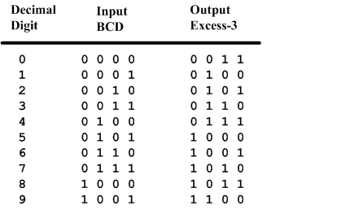
BCD-to-Excess-3 Code converter
BCD is a code for the decimal digits 0-9
Excess-3 is also a code for the decimal digits
9/15/09 - L12 Combinational Logic Design
Copyright 2009 - Joanne DeGroat, ECE, OSU

Slide 10
Specification of BCD-to-Excess3
Inputs: a BCD input, A,B,C,D with A as the most significant bit and D as the least significant bit.
Outputs: an Excess-3 output W,X,Y,Z that corresponds to the BCD input.
Internal operation – circuit to do the conversion in combinational logic.
9/15/09 - L12 Combinational Logic Design
Copyright 2009 - Joanne DeGroat, ECE, OSU

Slide 11
Formulation of BCD-to-Excess-3
Excess-3 code is easily formed by adding a binary 3 to the binary or BCD for the digit.
There are 16 possible inputs for both BCD and Excess-3.
It can be assumed that only valid BCD inputs will appear so the six combinations not used can be treated as don’t cares.
9/15/09 - L12 Combinational Logic Design
Copyright 2009 - Joanne DeGroat, ECE, OSU

Slide 12
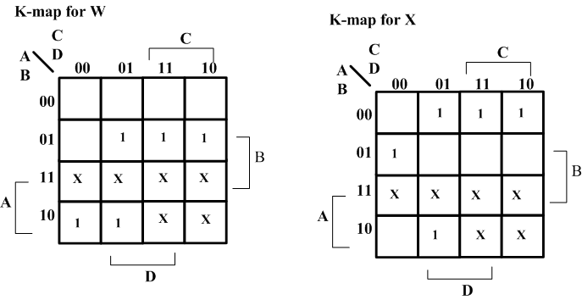
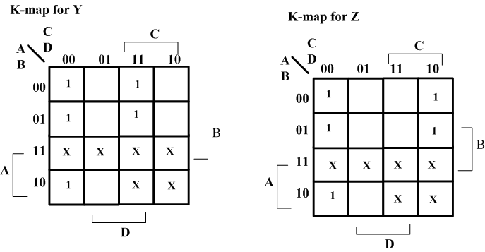
Optimization – BCD-to-Excess-3
Lay out K-maps for each output, W X Y Z
A step in the digital circuit design process.
9/15/09 - L12 Combinational Logic Design
Copyright 2009 - Joanne DeGroat, ECE, OSU

Slide 13
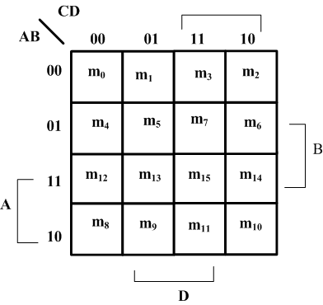
Placing 1 on K-maps
Where are the minterms located on a K-Map?
9/15/09 - L12 Combinational Logic Design
Copyright 2009 - Joanne DeGroat, ECE, OSU

Slide 14
Expressions for W X Y Z
W(A,B,C,D) = Σm(5,6,7,8,9) +d(10,11,12,13,14,15)
X(A,B,C,D) = Σm(1,2,3,4,9) +d(10,11,12,13,14,15)
Y(A,B,C,D) = Σm(0,3,4,7,8) +d(10,11,12,13,14,15)
Z(A,B,C,D) = Σm(0,2,4,6,8) +d(10,11,12,13,14,15)
9/15/09 - L12 Combinational Logic Design
Copyright 2009 - Joanne DeGroat, ECE, OSU

Slide 15
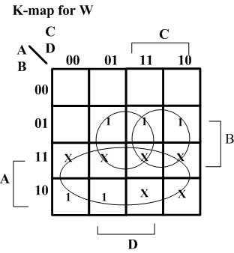
Minimize K-Maps
W minimization
Find W = A + BC + BD
9/15/09 - L12 Combinational Logic Design
Copyright 2009 - Joanne DeGroat, ECE, OSU

Slide 16
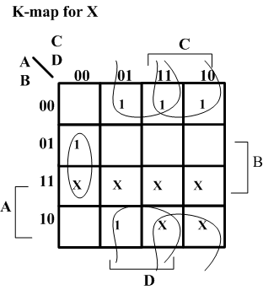
Minimize K-Maps
X minimization
Find X = BC’D’+B’C+B’D
9/15/09 - L12 Combinational Logic Design
Copyright 2009 - Joanne DeGroat, ECE, OSU

Slide 17
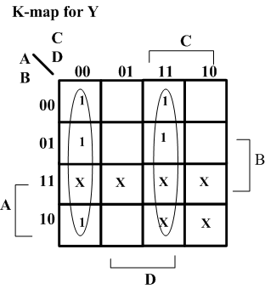
Minimize K-Maps
Y minimization
Find Y = CD + C’D’
9/15/09 - L12 Combinational Logic Design
Copyright 2009 - Joanne DeGroat, ECE, OSU

Slide 18
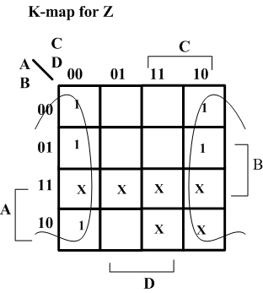
Minimize K-Maps
Z minimization
Find Z = D’
9/15/09 - L12 Combinational Logic Design
Copyright 2009 - Joanne DeGroat, ECE, OSU

Slide 19
Two level circuit implementation
Have equations
  W = A + BC + BD = A + B(C+D)
  X = B’C + B’D + BC’D’ = B’(C+D) + BC’D’
  Y = CD + C’D’
  Z = D’
Factoring out (C+D) and call it T
Then T’ = (C+D)’ = C’D’
  W = A + BT
  X = B’T + BT’
  Y = CD + T’
  Z = D’
9/15/09 - L12 Combinational Logic Design
Copyright 2009 - Joanne DeGroat, ECE, OSU

Slide 20
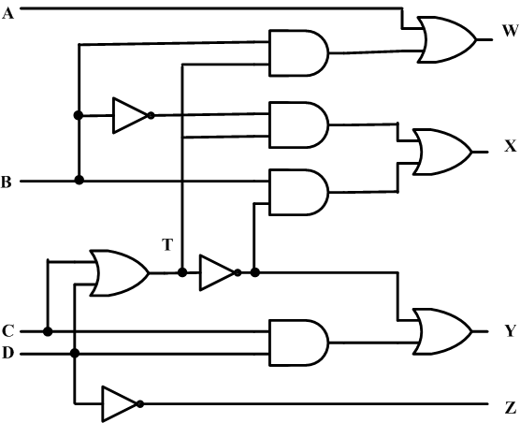
Create the digital circuit
Implementing the second set of equations where T=C+D results in a lower gate count.
This gate has a fanout of 3
9/15/09 - L12 Combinational Logic Design
Copyright 2009 - Joanne DeGroat, ECE, OSU

Slide 21
BCD-to-Seven-Segment Decoder
Specification
  Digital readouts on many digital products often use LED seven-segment displays.
  Each digit is created by lighting the appropriate segments. The segments are labeled a,b,c,d,e,f,g
  The decoder takes a BCD input and outputs the correct code for the seven-segment display.
9/15/09 - L12 Combinational Logic Design
Copyright 2009 - Joanne DeGroat, ECE, OSU

Slide 22
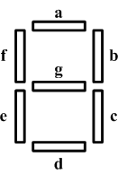
Specification
Input: A 4-bit binary value that is a BCD coded input.
Outputs: 7 bits, a through g for each of the segments of the display.
Operation: Decode the input to activate the correct segments.
9/15/09 - L12 Combinational Logic Design
Copyright 2009 - Joanne DeGroat, ECE, OSU

Slide 23
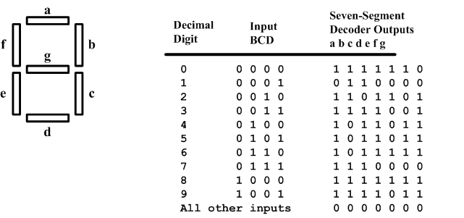
Formulation
Construct a truth table
9/15/09 - L12 Combinational Logic Design
Copyright 2009 - Joanne DeGroat, ECE, OSU

Slide 24
Optimization
Create a K-map for each output and get
  A = A’C+A’BD+B’C’D’+AB’C’
  B = A’B’+A’C’D’+A’CD+AB’C’
  C = A’B+A’D+B’C’D’+AB’C’
  D = A’CD’+A’B’C+B’C’D’+AB’C’+A’BC’D
  E = A’CD’+B’C’D’
  F = A’BC’+A’C’D’+A’BD’+AB’C’
  G = A’CD’+A’B’C+A’BC’+AB’C’
9/15/09 - L12 Combinational Logic Design
Copyright 2009 - Joanne DeGroat, ECE, OSU

Slide 25
Note on implementation
Direct implementation would require 27 AND gates and 7 OR gates.
By sharing terms, can actualize and implementation with 14 less gates.
Normally decoder in a device name indicates that the number of outputs is less than the number of inputs.
9/15/09 - L12 Combinational Logic Design
Copyright 2009 - Joanne DeGroat, ECE, OSU

Slide 26
4-bit Equality Checker
Specification
  Input: Two vectors, A(3:0) and B(3:0) each being 4-bits. The msb bits the A(3) and B(3).
  Output: E which has a value of 1 when A=B and 0 if any bit of A/=B.
  Operation: Combinational logic to compare the 4 bits of A with the 4 bits of B to produce E
9/15/09 - L12 Combinational Logic Design
Copyright 2009 - Joanne DeGroat, ECE, OSU

Slide 27
4-bit Equality Checker
Formulation
  For each bit position A_{i} will be compared with B_{i} and if they are equal, a 0 will be output. If they differ a 1 will be output.
  Thus, if any bit position indicates a 1 then the values are different. These 1st level comparators outputs can then be Ored together.
  The ORed output is inverted to produce a 1 when they are equal.
9/15/09 - L12 Combinational Logic Design
Copyright 2009 - Joanne DeGroat, ECE, OSU

Slide 28
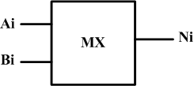
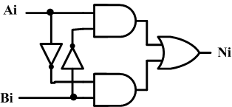
4-bit Equality Checker
Optimization
Done by implementing two separate blocks.
1st the unit MX that compares two bit and outputs a 0 if they are equal, i.e., an XOR operation.
9/15/09 - L12 Combinational Logic Design
Copyright 2009 - Joanne DeGroat, ECE, OSU

Slide 29
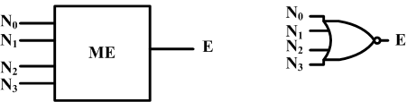
The second unit
The ME unit takes the MX outputs and generates a 1 when all the inputs are 0, i.e., a NOR operation.
E = (N₀+N₁+N₂+N₃)’
9/15/09 - L12 Combinational Logic Design
Copyright 2009 - Joanne DeGroat, ECE, OSU

Slide 30
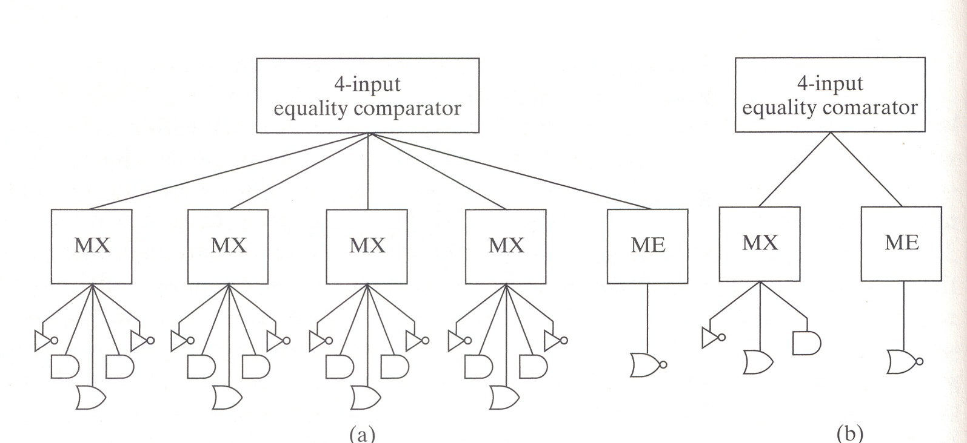
Heirarchical Representation
Figure 3-5 of text
9/15/09 - L12 Combinational Logic Design
Copyright 2009 - Joanne DeGroat, ECE, OSU

Slide 31
Class 12 assignment
Covered sections 3-1 and 3-2
Problems for hand in
  3-1 and 3-3 (due Monday)
Problems for practice
  3-2, 3-8, 3-10, 3-11a
Reading for next class:
9/15/09 - L12 Combinational Logic Design
Copyright 2009 - Joanne DeGroat, ECE, OSU

